Slide 1
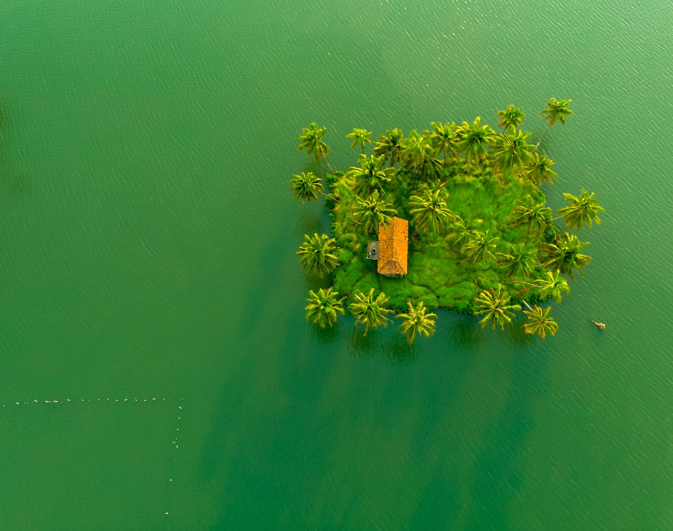
Tourist Place of Bangladesh
Made by Tofazzel

Slide 2
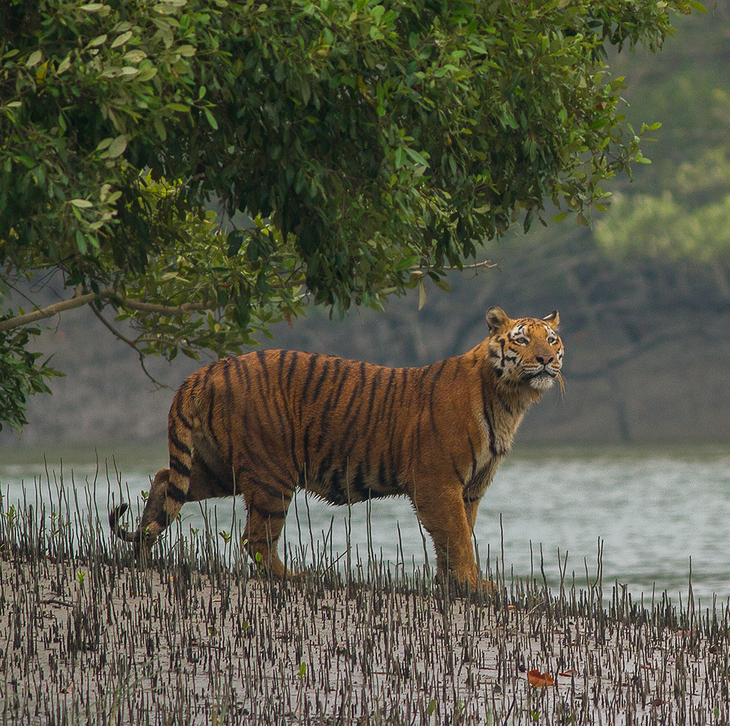
Sundarbans
Sundarbans is a mangrove area in the delta formed by the confluence of the Ganges, Brahmaputra and Meghna Rivers in the Bay of Bengal. Spread across parts of India and Bangladesh, this forest is the largest Mangrove forest in the world.

Slide 3
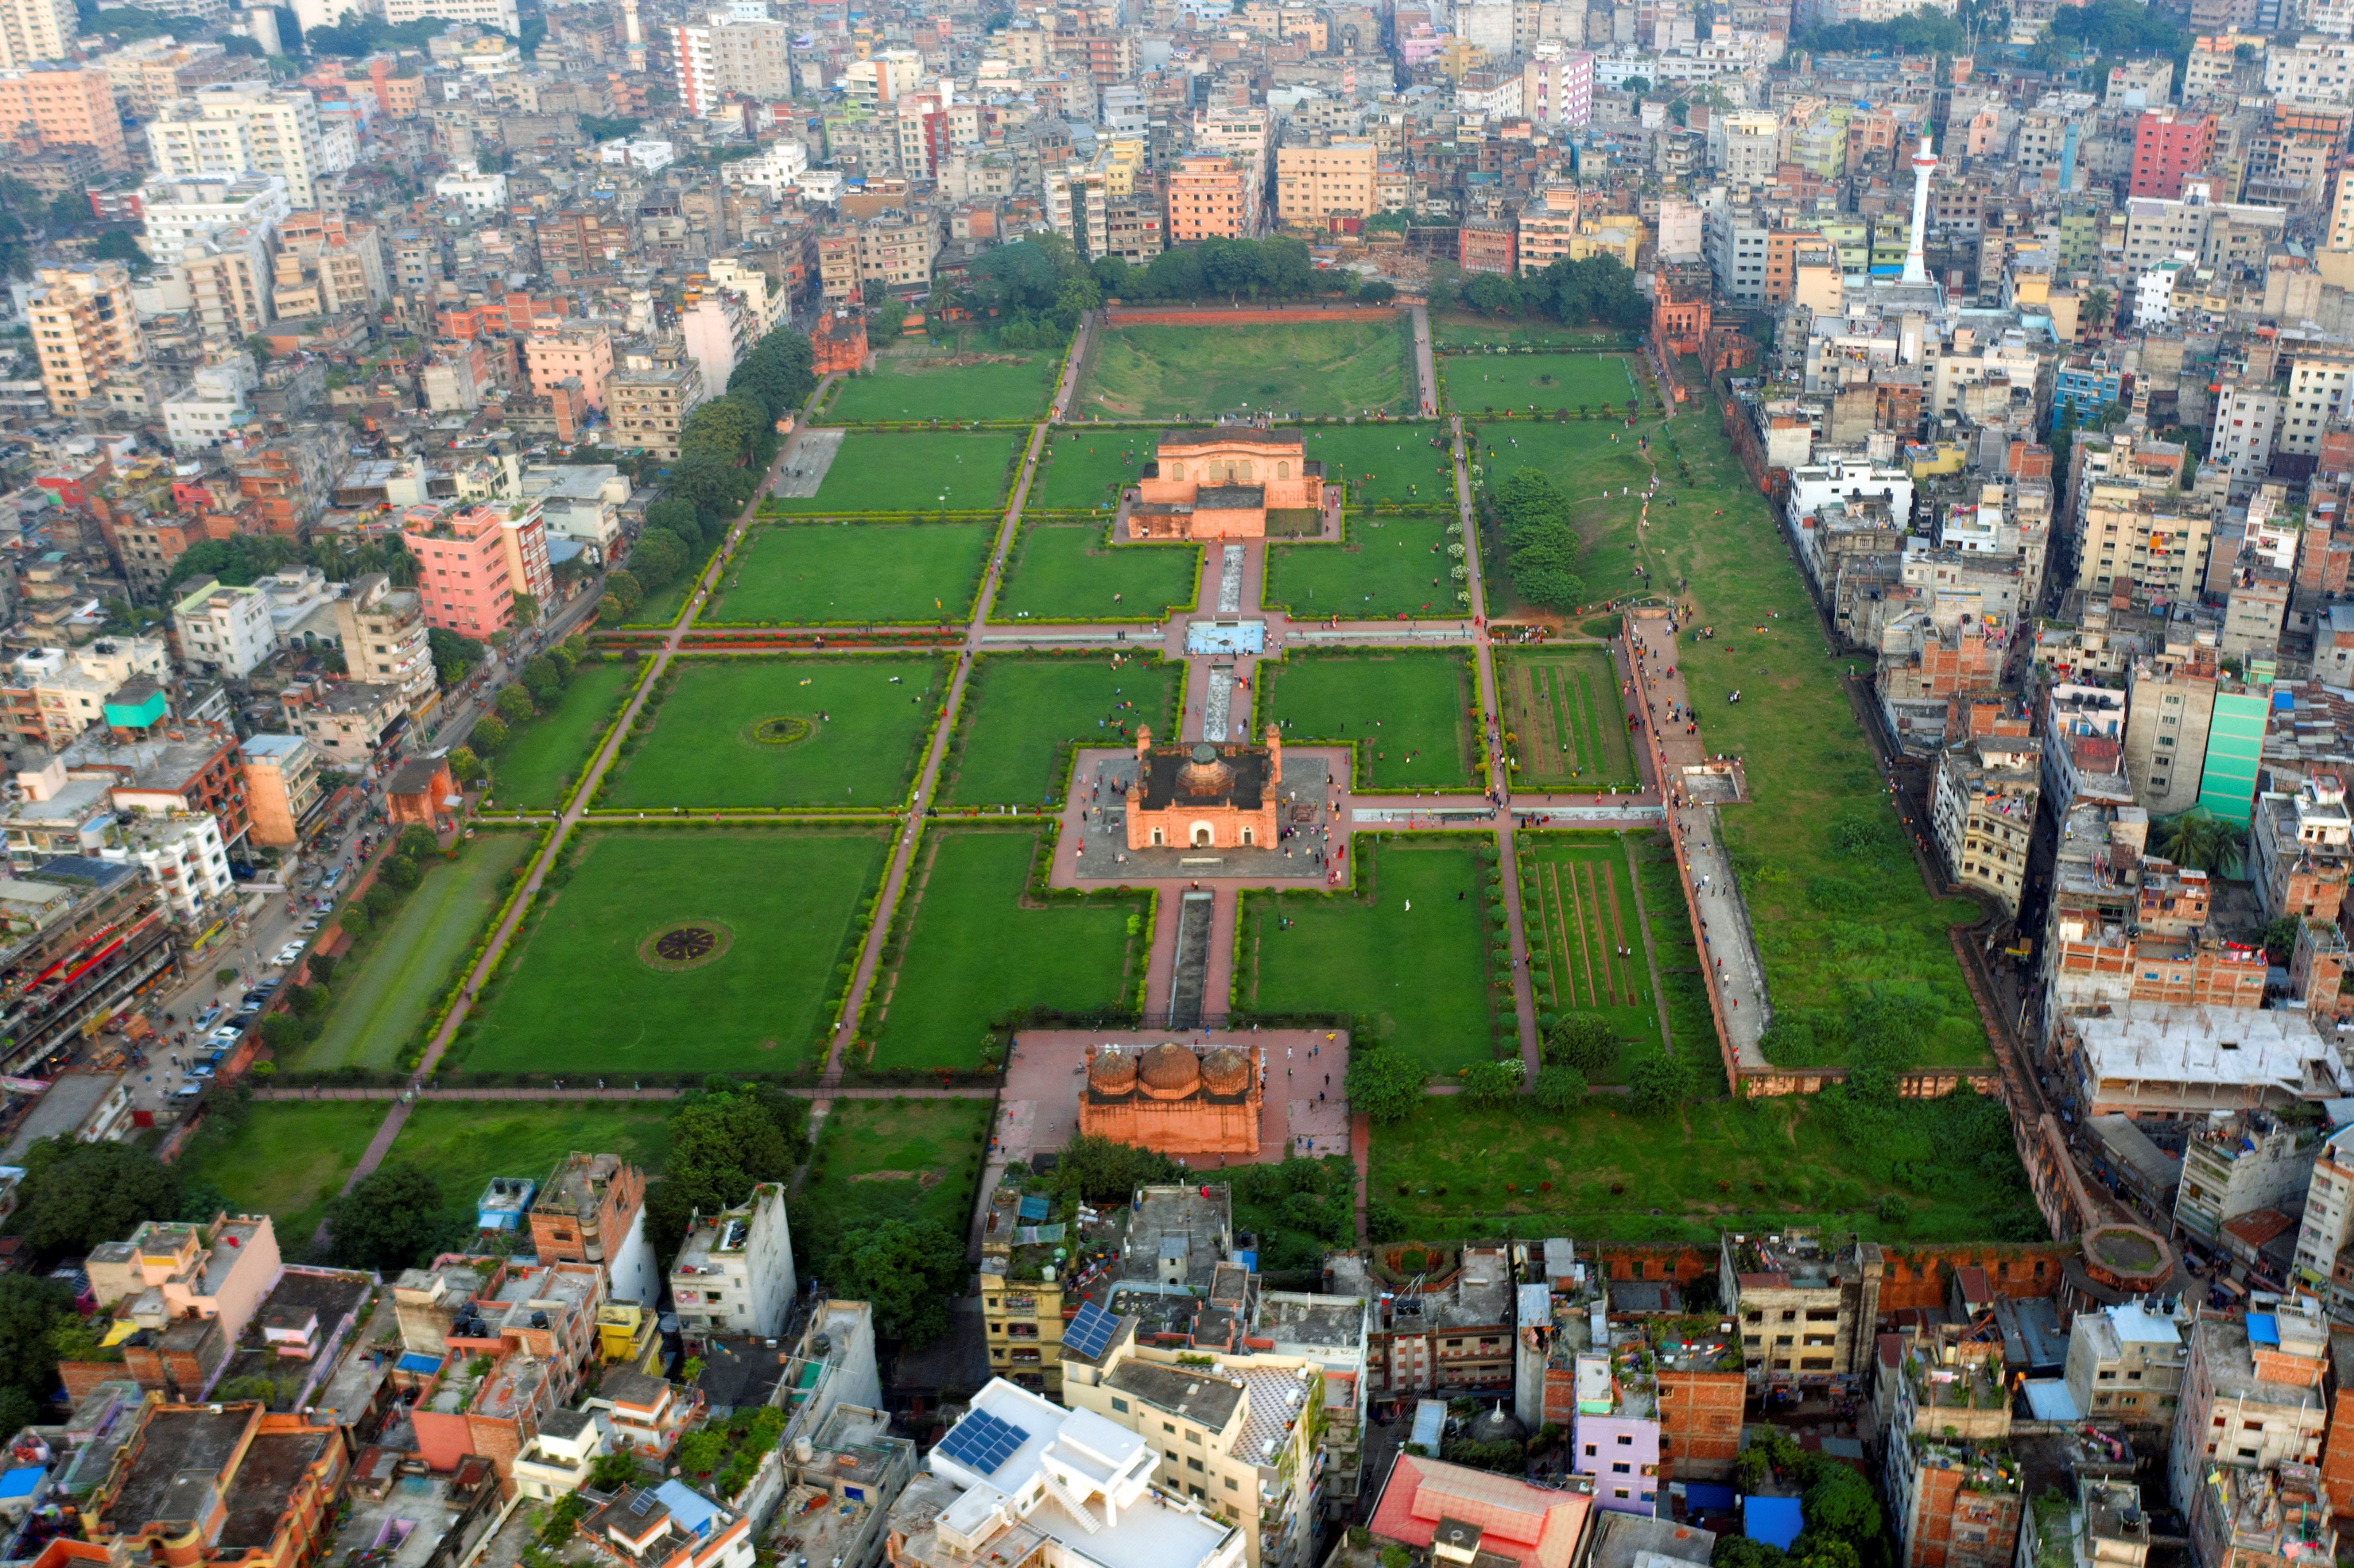
Lalbagh Fort
The Lalbagh Fort (Bengali: লালবাগ কেল্লা, romanized: Lālabāga Kēllā) is a fort in the old city of Dhaka, Bangladesh.^{[1][2]} Its name is derived from its neighbourhood Lalbagh, which means Red Garden.

Slide 4
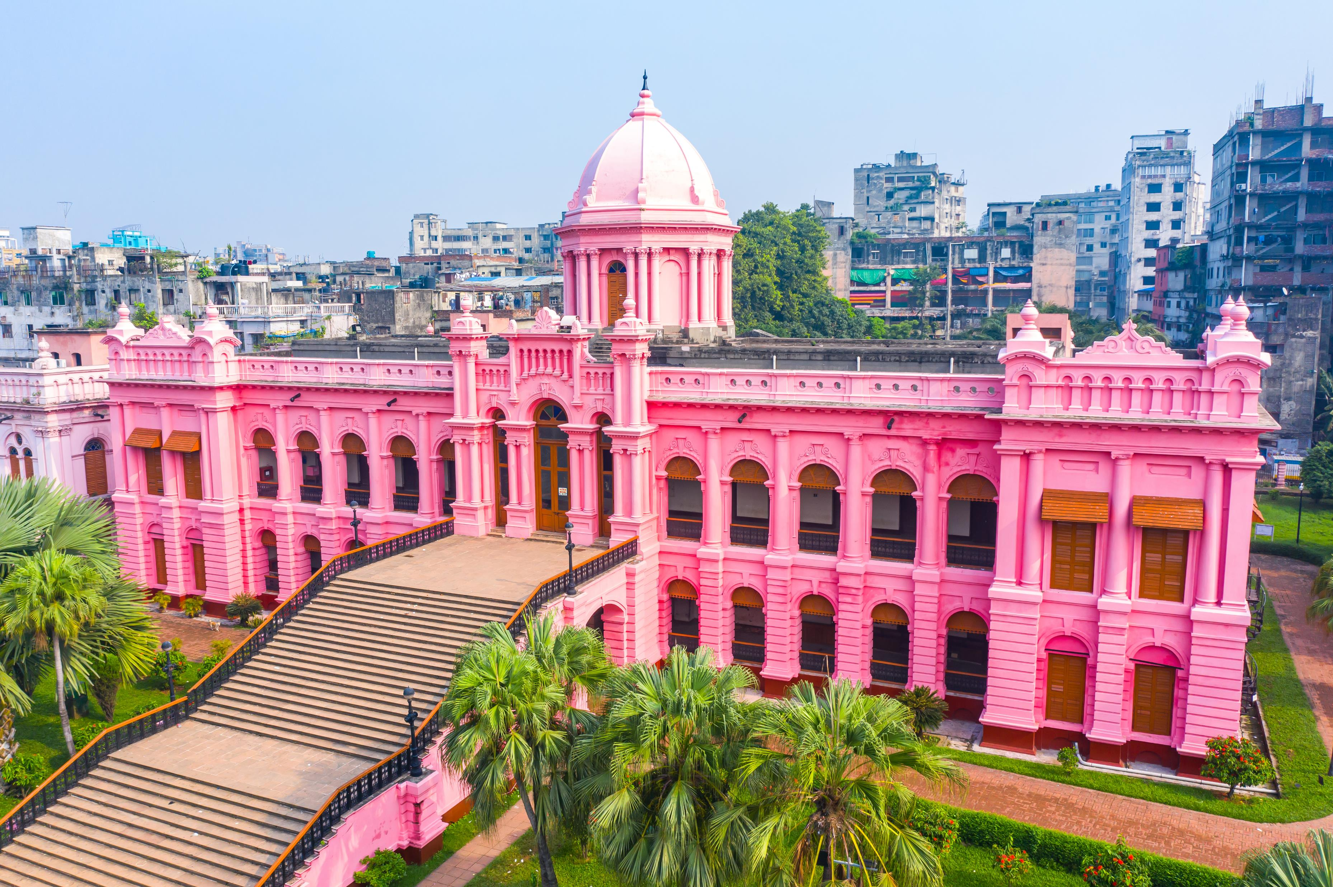
Ahsan Manzil
Ahsan Manzil (Bengali: আহসান মঞ্জিল) is a palace located in the Kumartoli area beside Buriganga River of Dhaka, Bangladesh.^{[1][2]} It was formerly the residence and seat of the Nawab of Dhaka and has been designated an Old Dhaka Heritage Site.^{[3]} It now serves as a museum.^{[4]}

Slide 5
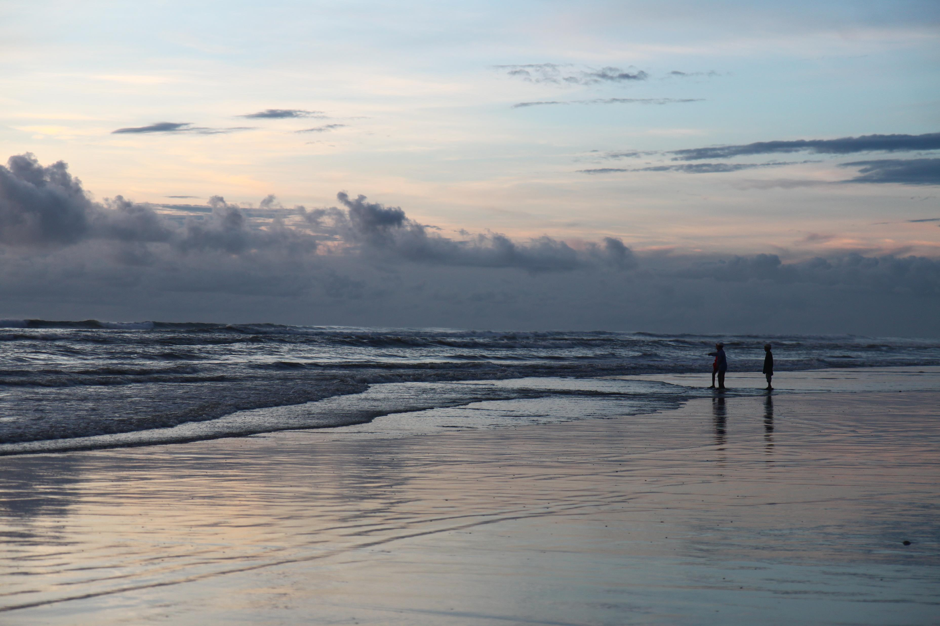
Cox’s Bazar
Cox's Bazar is a city, fishing port, tourism centre, and district headquarters
in southeastern Bangladesh. Cox's Bazar Beach, one of the most popular
tourist attractions in Bangladesh, is the longest uninterrupted natural beach
in the world.[

Slide 6
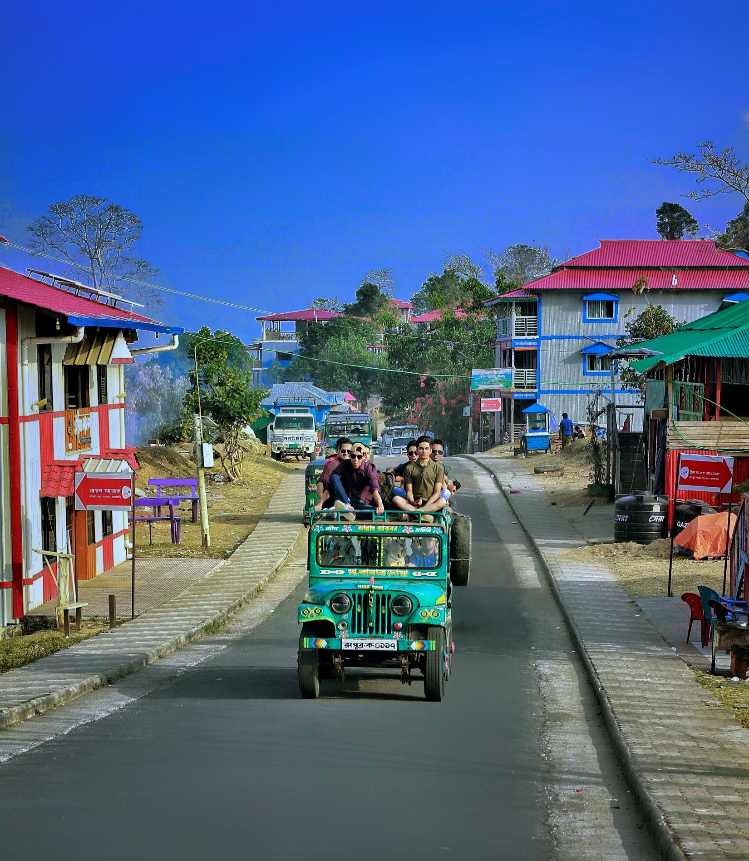
Sajek Valley
Sajek Valley (Bengali: সাজেক উপত্যকা) is a popular tourist spot in Bangladesh, situated among the hills of the Kasalong range of mountains in the northern area of the Chittagong Hill Tracts. Referred to as the "Queen of Hills"^{[1][2]} and the "Roof of Rangamati",^{[3]} the valley is known for its greenery and dense forests, situated at an elevation of 1,800 feet (550 m) above sea level.

Slide 7
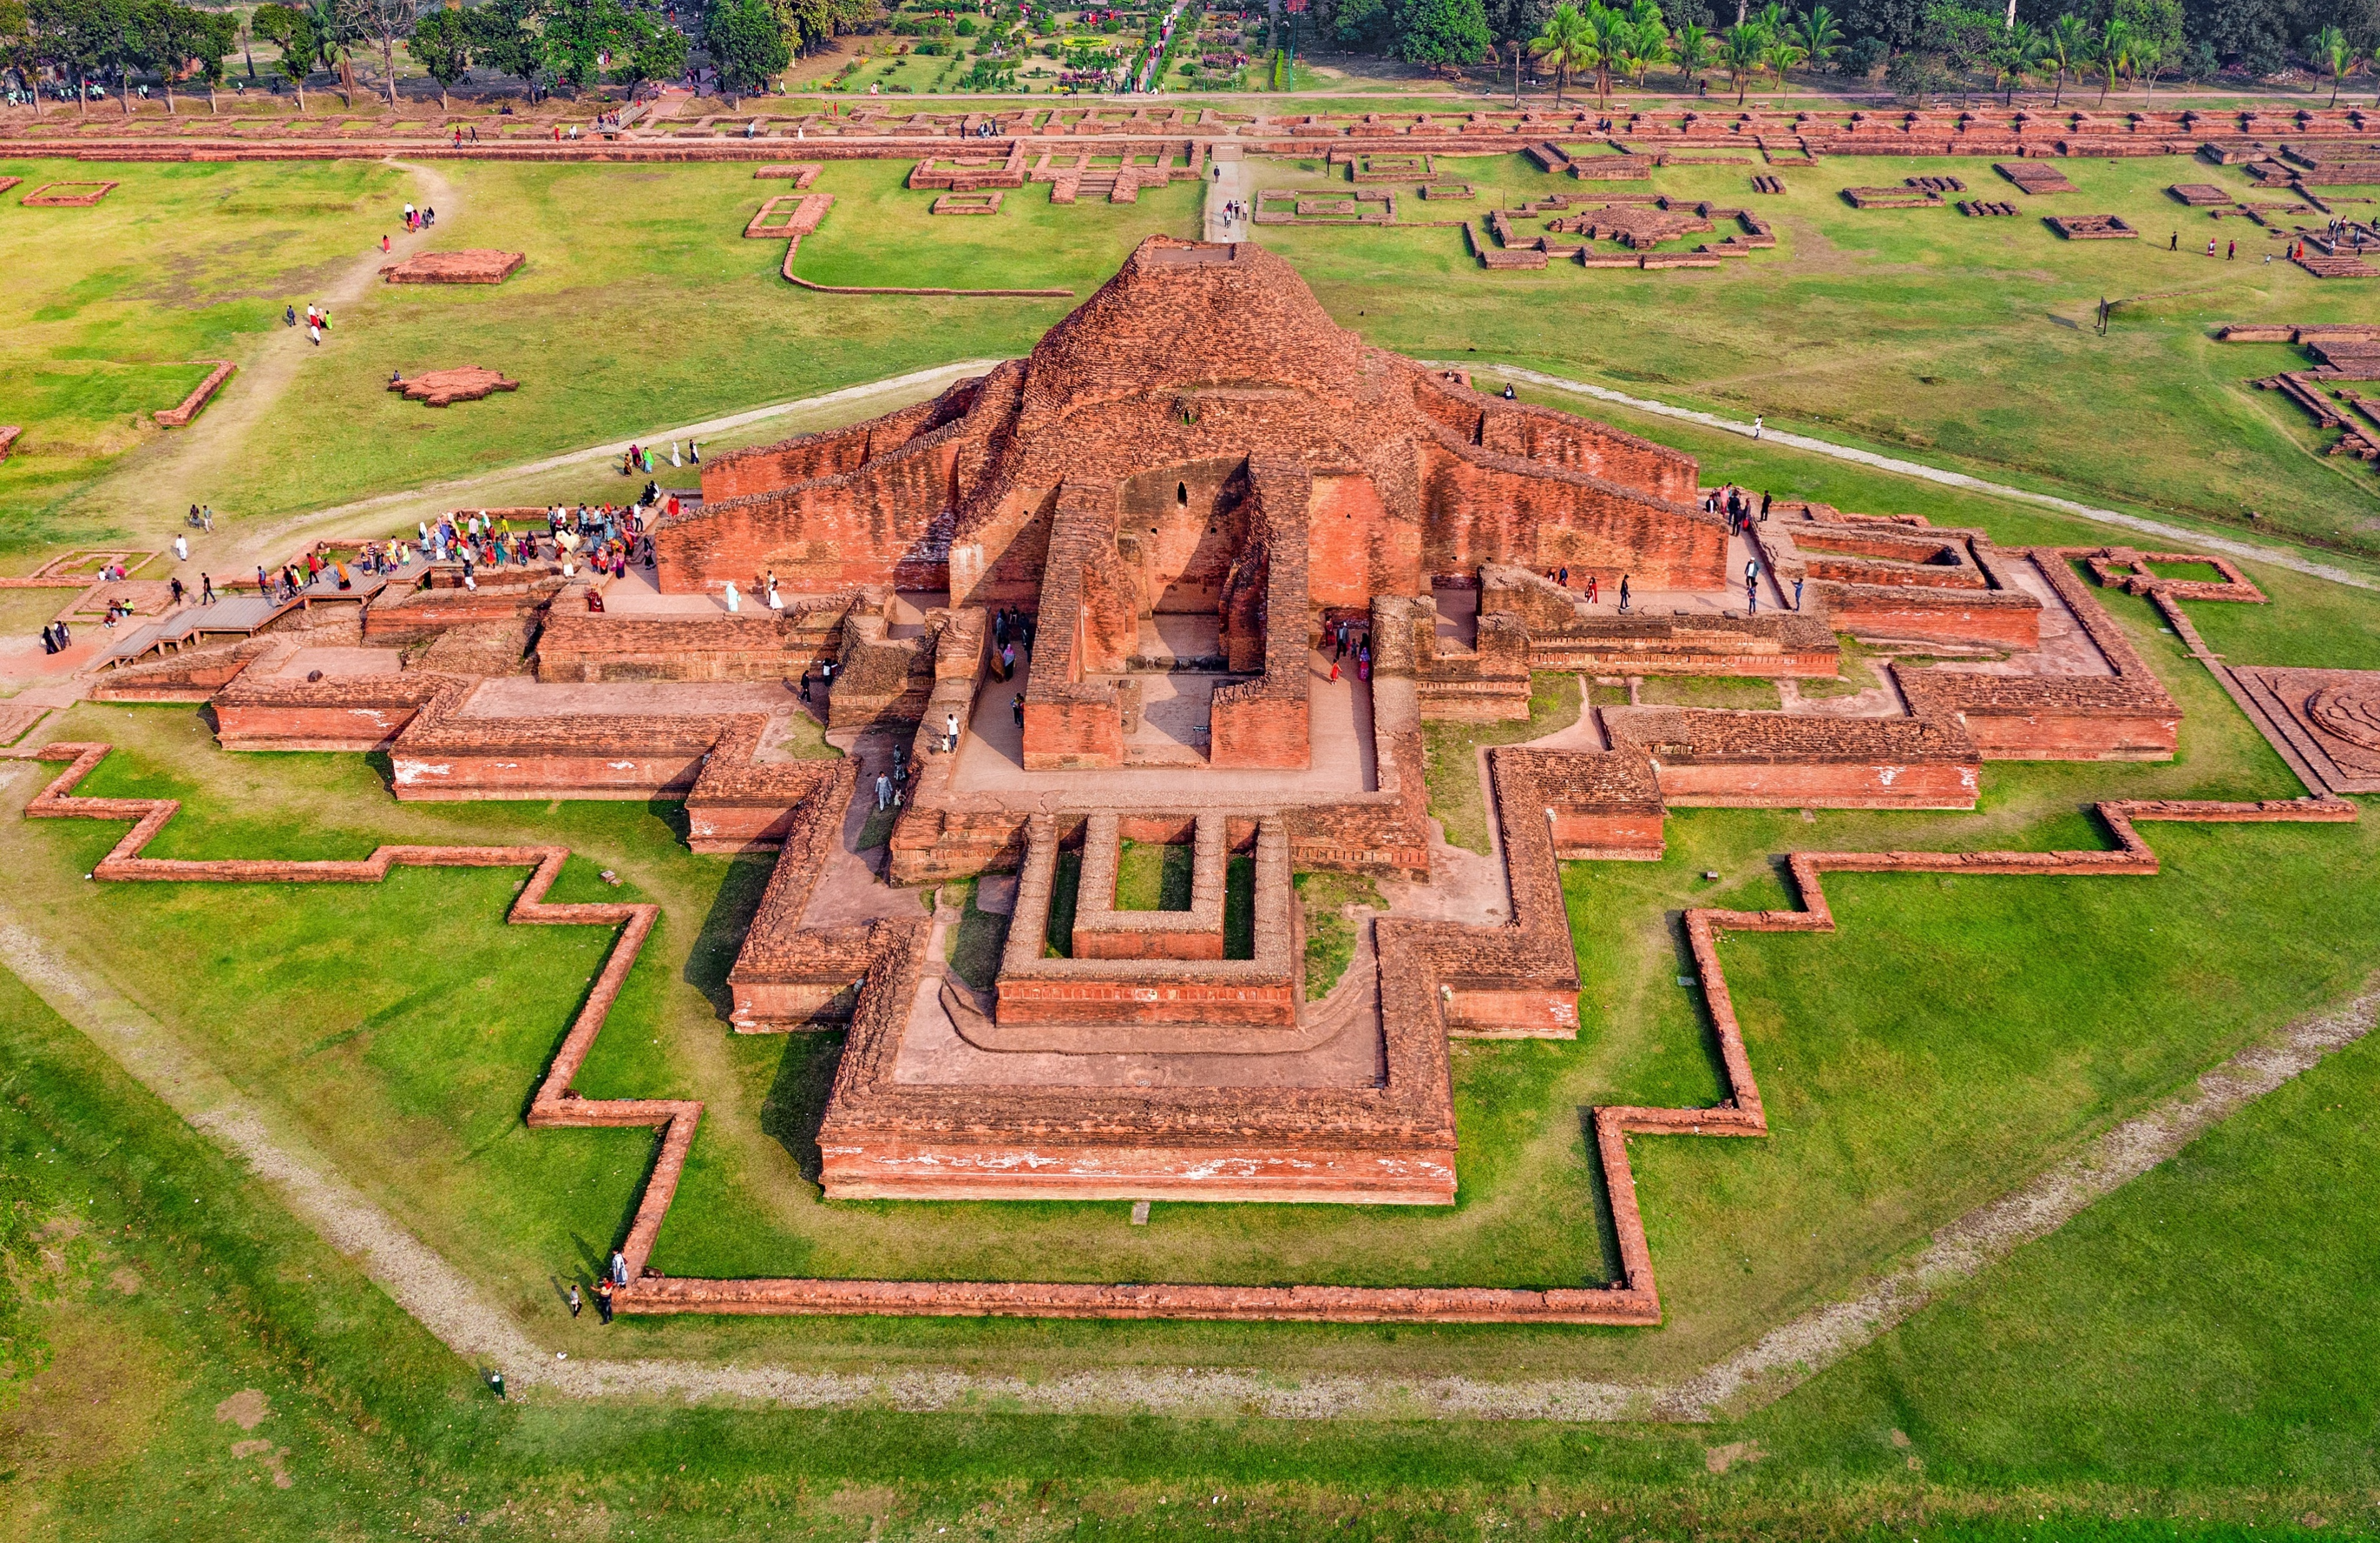
Sompur Mahavihara
Paharpur Buddhist Vihara in Paharpur, Badalgachhi, Naogaon, Bangladesh
is among the best known Buddhist viharas or monasteries in the Indian
Subcontinent and is one of the most important archaeological sites in the
country. It was designated as a UNESCO World Heritage Site in 1985.
It is one of the most famous examples of architecture in pre-Islamic Bangladesh.
It dates from a period to the nearby Halud Vihara and to the Sitakot Vihara in
Nawabganj Upazila of Dinajpur District.

Slide 8
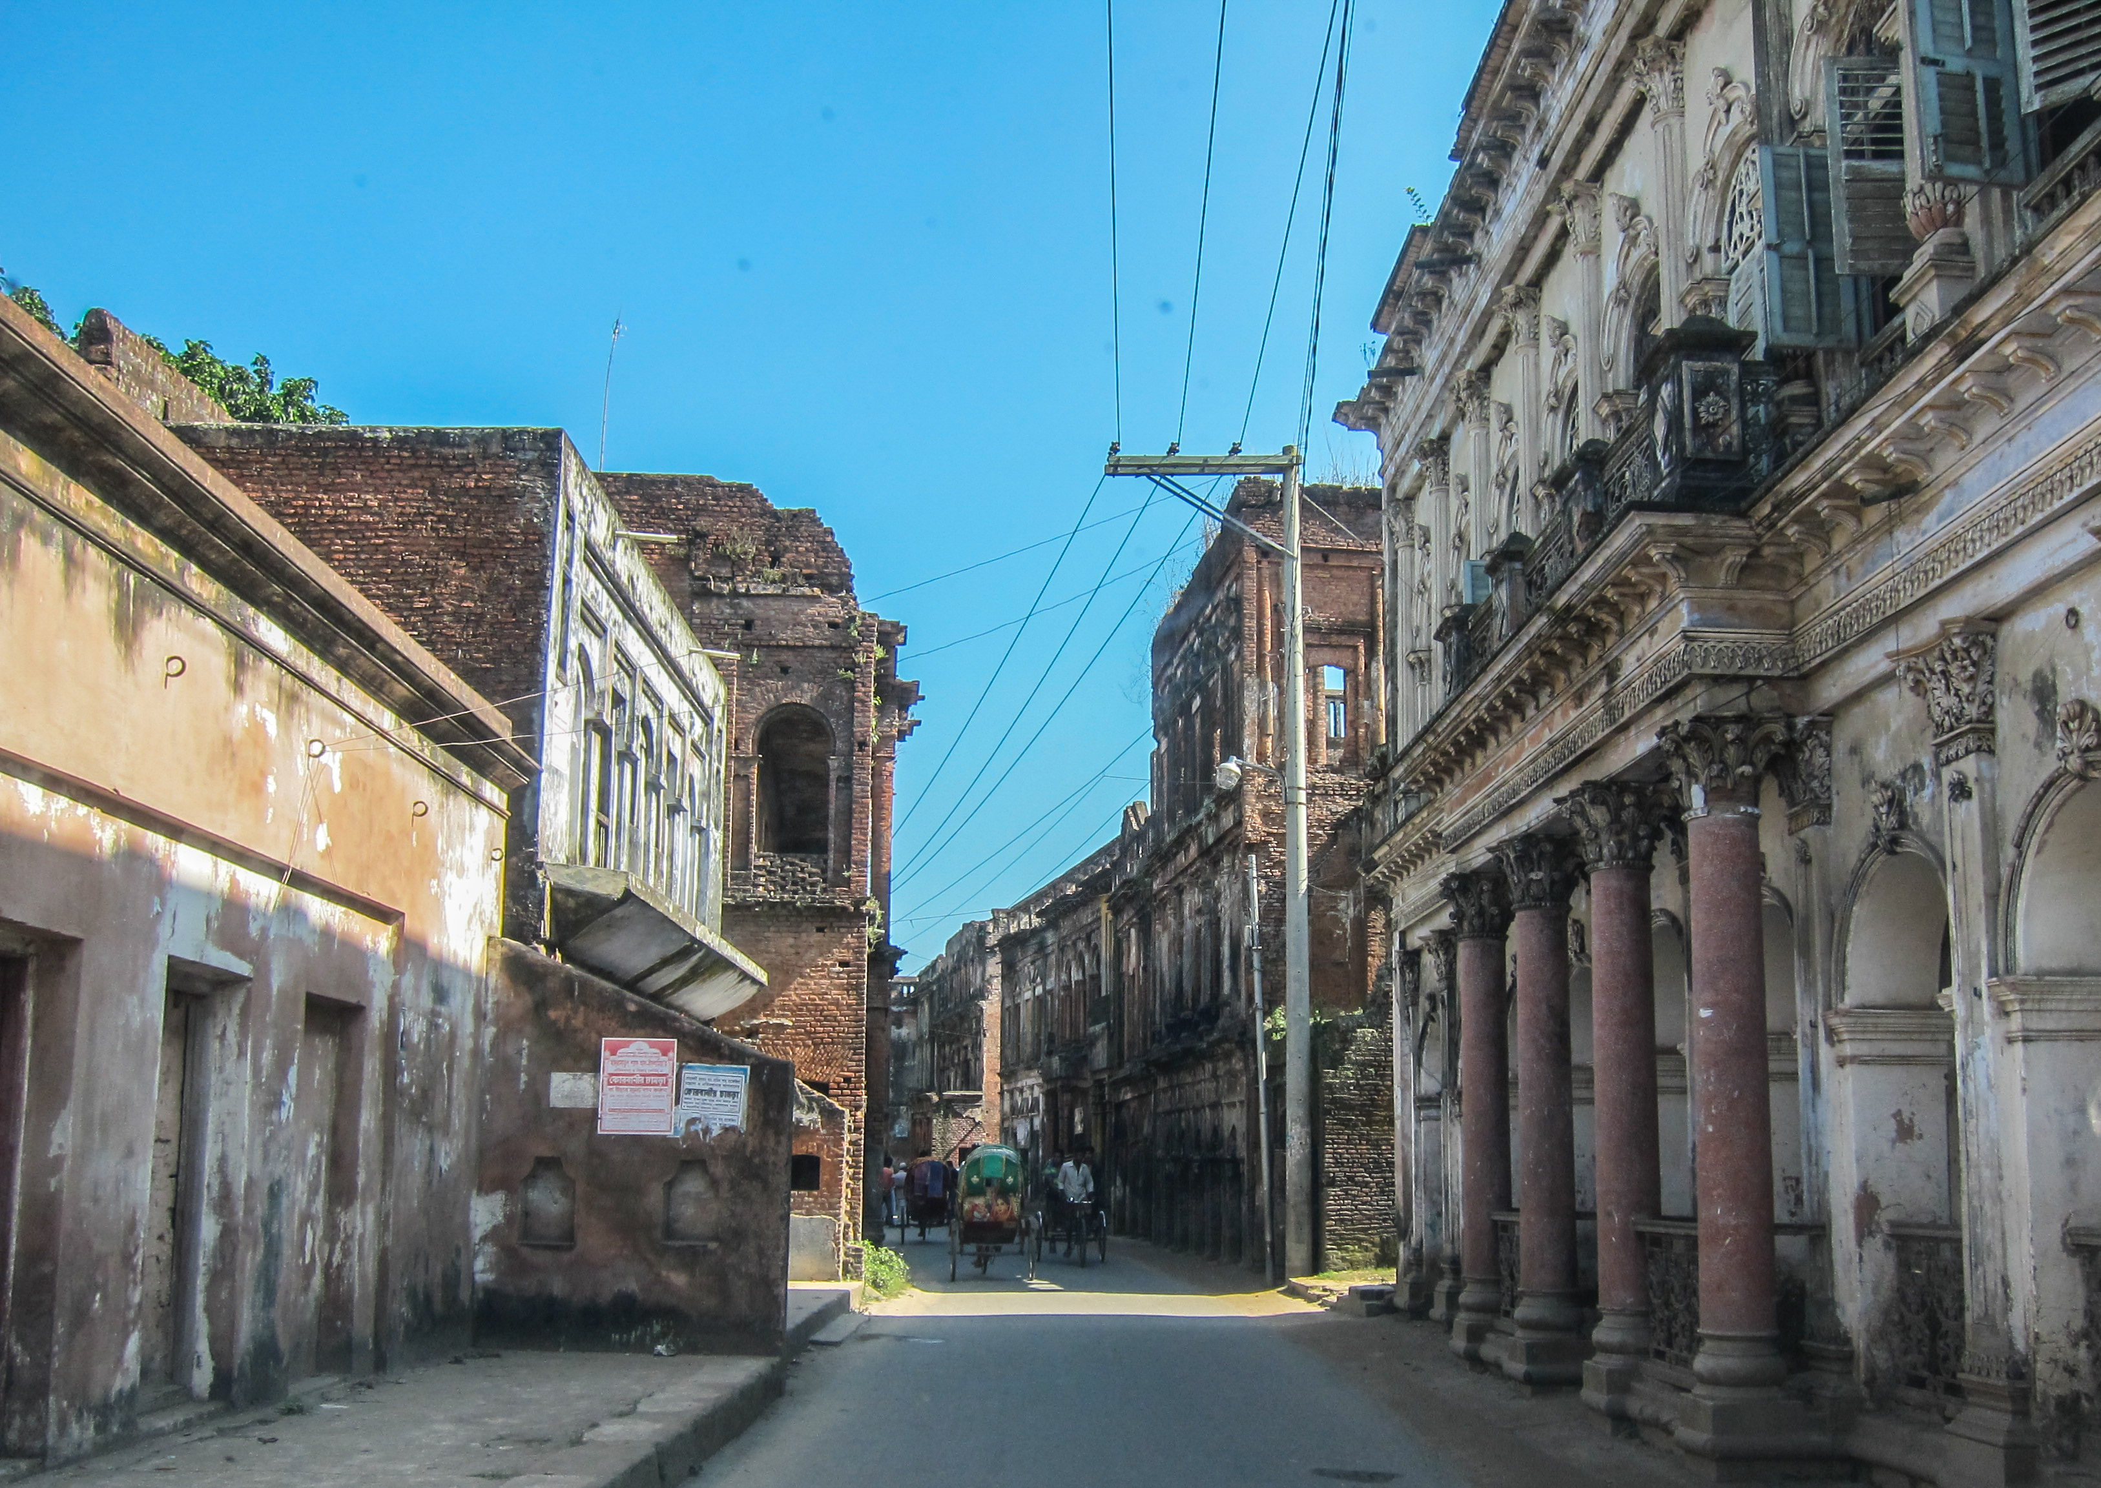
Sonargaon
Sonargaon (Bengali: সোনারগাঁও; Bengali pronunciation: [ˈʃonaɾɡãʋ];^{[1]} lit. Golden Hamlet) is a historic city in central Bangladesh. It corresponds to the Sonargaon Upazila of Narayanganj District in Dhaka Division.

Slide 9
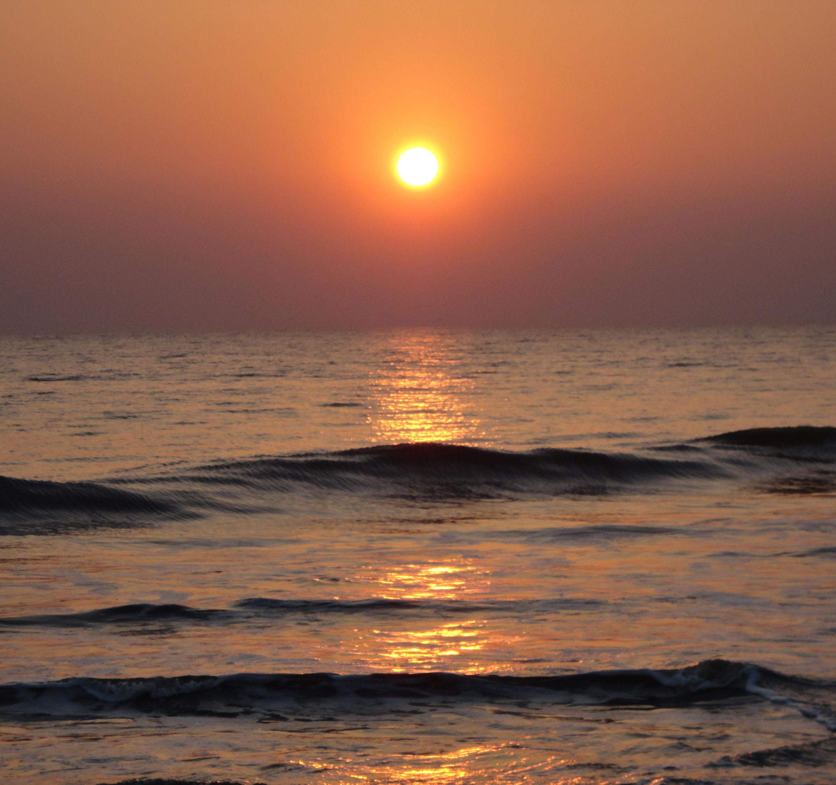
Kuakata
Kuakata (Bengali: কুয়াকাটা) is a town of Patuakhali located in southern Bangladesh known for its panoramic sea beach.^{[1][2]} Kuakata beach is a sandy expanse 18 kilometres (11 mi) long and 3 kilometres (1.9 mi) wide

Slide 10
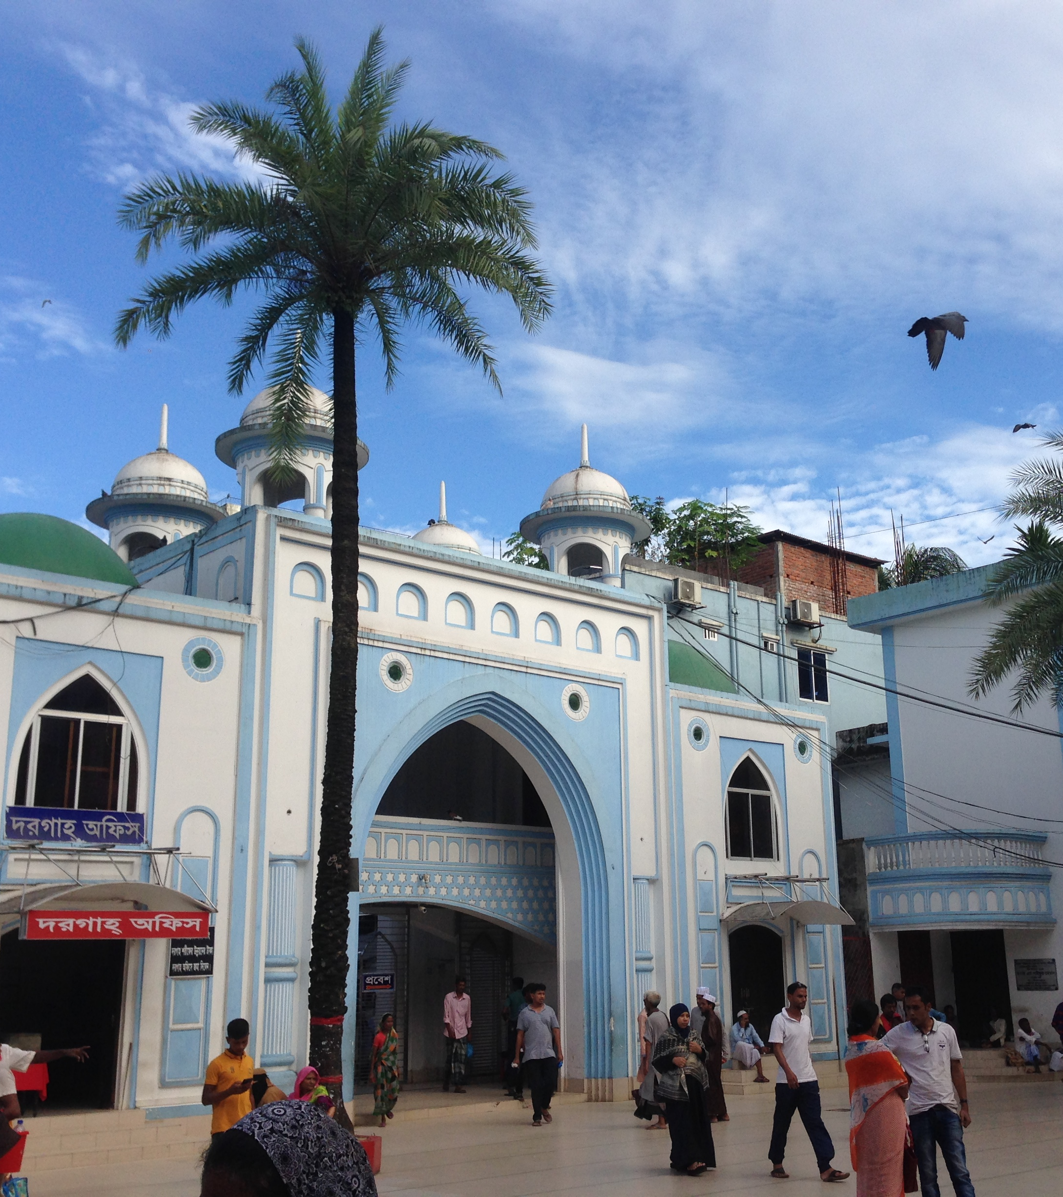
Sylhet
Sylhet (Bengali: সিলেট IPA: [sileʈ]; Sylheti: ꠍꠤꠟꠐ)^{[5][6][7][8]} is a metropolitan city located in the northeastern region of Bangladesh. It is the administrative center of Sylhet Division and is situated on the banks of the Surma River

